Slide 1


WEEKEND WORKSHOP SERIES 4
Saturday
Google Cloud
Architect Project
A hands-on, simple cloud simulation designed for Google Cloud PCA candidates to map, deploy, and evaluate real-world infrastructure.

Slide 2
Chiho Sharp
GOOGLE CLOUD CERTIFICATIONS
verified_user
stars
school
PROFESSIONAL
Professional Cloud Architect
CERT-P-CA
ACTIVE DATE
2026-06-11
EXPIRY DATE
2028-07-11
SERIES ID: 123792
ASSOCIATE
Associate Cloud Engineer
CERT-A-ACE
ACTIVE DATE
2025-10-30
EXPIRY DATE
2028-11-30
SERIES ID: 183505
FOUNDATIONAL
Cloud Digital Leader
CERT-FUN-CDL
ACTIVE DATE
2025-03-31
EXPIRY DATE
2028-04-30
SERIES ID: 95438

Slide 3

PROJECT SCENARIO
Build a Community Project Tracker Application
The Challenge
You client needs your help build a project tracker with analytics using Google Cloud Services.
You will architect and deploy this solution using Cloud Run, Firestore and BigQuery.
Notes:
If you're using the latest Google Cloud Console
Be aware that Google has been encouraging users to host static websites behind services such as Cloud Load Balancing or Firebase Hosting for production environments. However, Cloud Storage static website hosting is still perfectly suitable for learning and is one of the easiest ways to introduce Cloud Storage, buckets, IAM, and object permissions in a beginner workshop.
For a Google Cloud Digital Leader or Associate Cloud Engineer class, this remains an excellent first hands-on lab.

Slide 4

The Scenario
Community Organisation Requirements
Diverse Initiatives
Example Projects
The organisation runs various active community projects:
Community Table Tennis
Children's Sports Club
Cooking Workshop
Digital Skills Workshop
Environmental Project
Staff Capabilities
Application Functions
A simple tool is required to perform these operations:
Add a community project.
Register participants.
Record participant hours.
View projects and participants.
Analyze basic statistics with BigQuery.

Slide 5
Operational vs. Analytical Databases
Why not just use Firestore?
"If Firestore already stores our data, why do we need BigQuery?"
Operational Store
Firestore
Excellent for individual, fast application records:
Project
name • category • description
Participant
name • project • hours • date
Analytics Engine
BigQuery
Designed for large-scale, complex historical queries:
Analytics Questions:
"Show me participation by project over the last 12 months."
"Which project had the highest average volunteer hours?"
"How many participants did we have each month?"

Slide 6
Interactive Workshop
Let’s build it!
Plan and Map
Application Architecture
Community Project Tracker
personUSER
Component Roles
Cloud Run
Executes the web application logic containerized and scales dynamically based on traffic.
Firestore
Stores flexible, document-based operational records for projects and participants.
BigQuery
Ingests, processes, and runs complex queries on analytical tracking data.
Direct Source Deployment
gcloud run deploy --source
cloudCloud Run
Web Application
storageFirestore
Application Data
bar_chartBigQuery
Analytics Engine

Slide 7
Workshop Objectives
By the end of this session, you should be able to explain:
Google Cloud Concepts
Architecture Concept
What a Google Cloud project is
What a managed service is
What serverless means
What Cloud Run does
What a database does
What Firestore is
What an API is
How an application communicates with a database
Basic IAM/service identity concepts
Analytics using BigQuery
A user sends a request to Cloud Run.
Cloud Run runs the application.
The application sends the feedback to Firestore, which stores data.
Analyse the data with BigQuery

Slide 8

Create the Google Cloud project
01
Go to the Google Cloud Console.
02
At the top of the screen, click the project selector.
03
Click:
New Project
04
Give it a name such as:
Community-
project-tracker
NOTEGoogle will create a unique Project ID.

Slide 9
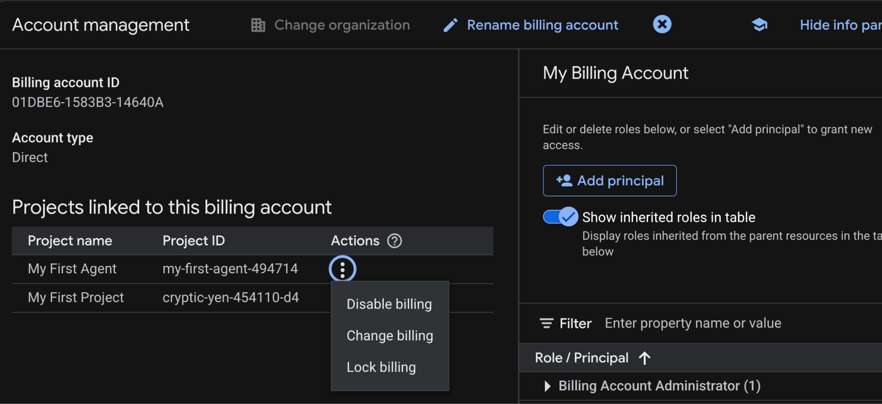
Search “Billing Account Manager” and click three dots to enable billing
Notes:
If you see “Disable billing”, it means that your billing is enabled.
No need to do anything.
If it says. “Enable Billing”, select that option.

Slide 10
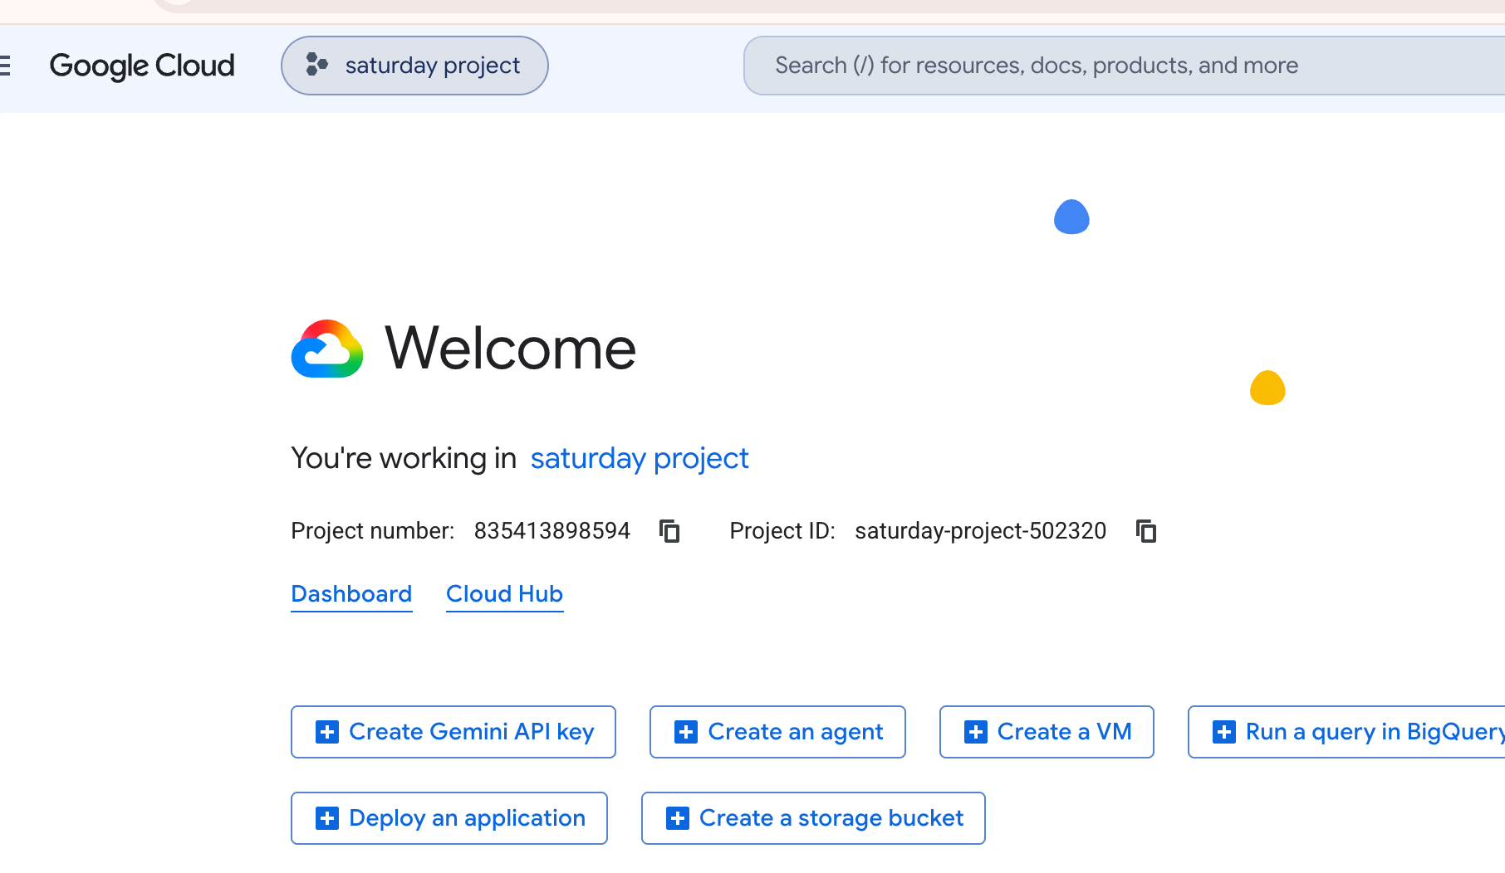
Click here

Slide 11
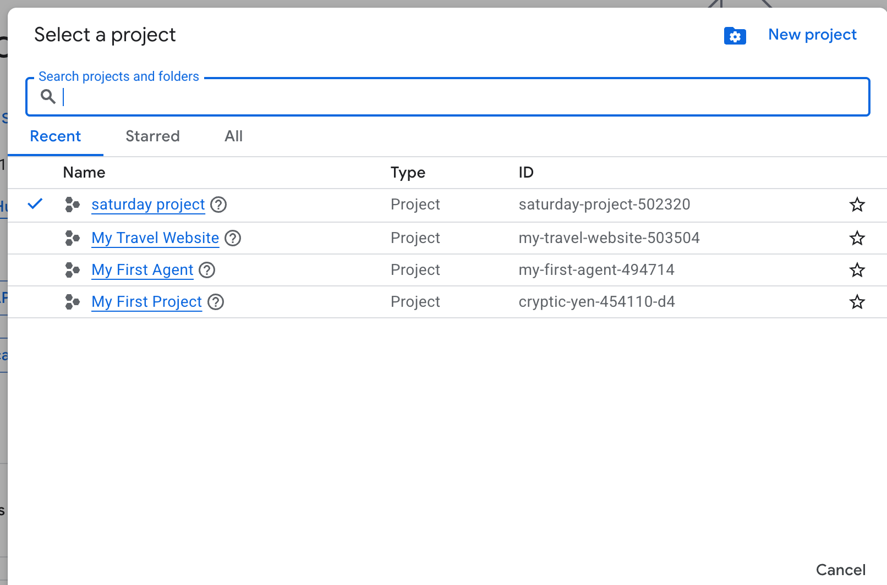
Click here

Slide 12
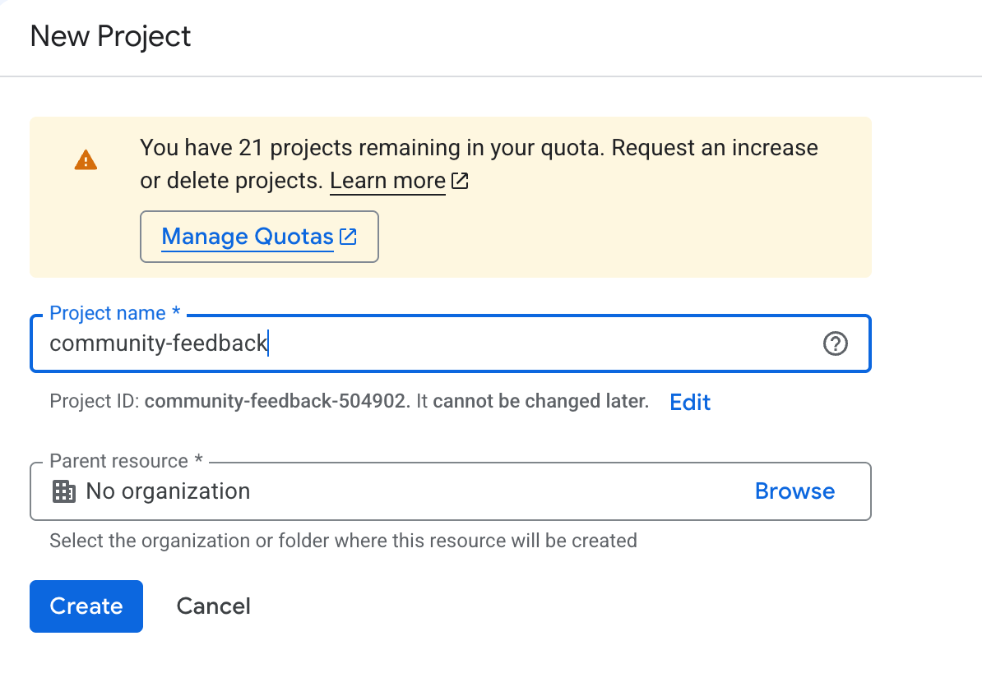
Name your project
community-project-tracker
Click here

Slide 13
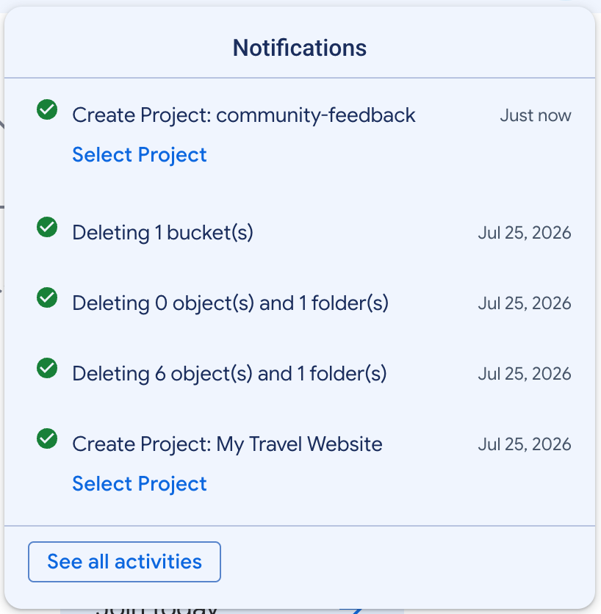
You can see a new notification.
community-project-tracker
Close the notifications by clicking the section.

Slide 14
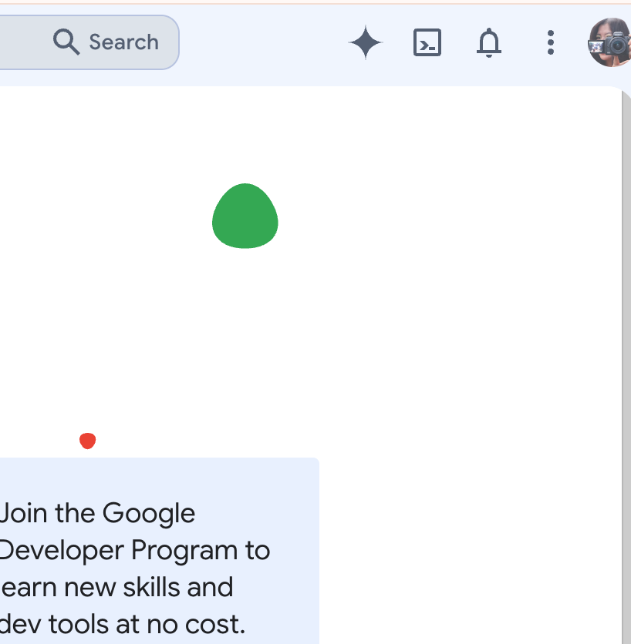
Open Cloud Shell

Slide 15
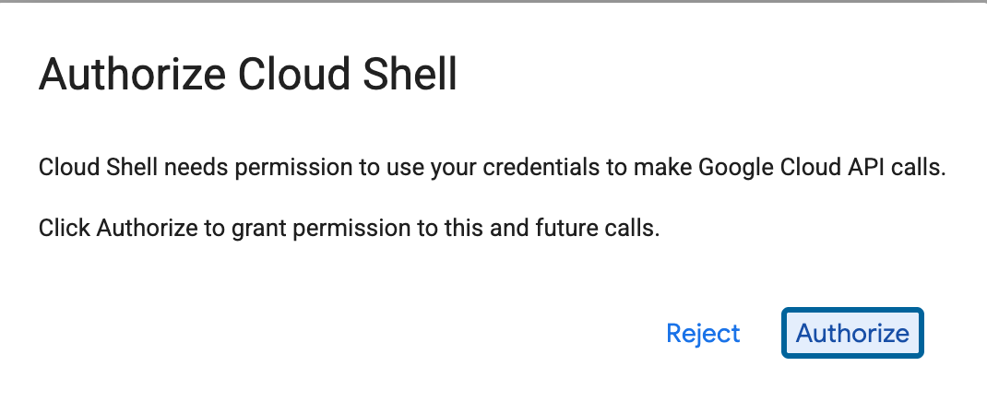
Click here

Slide 16
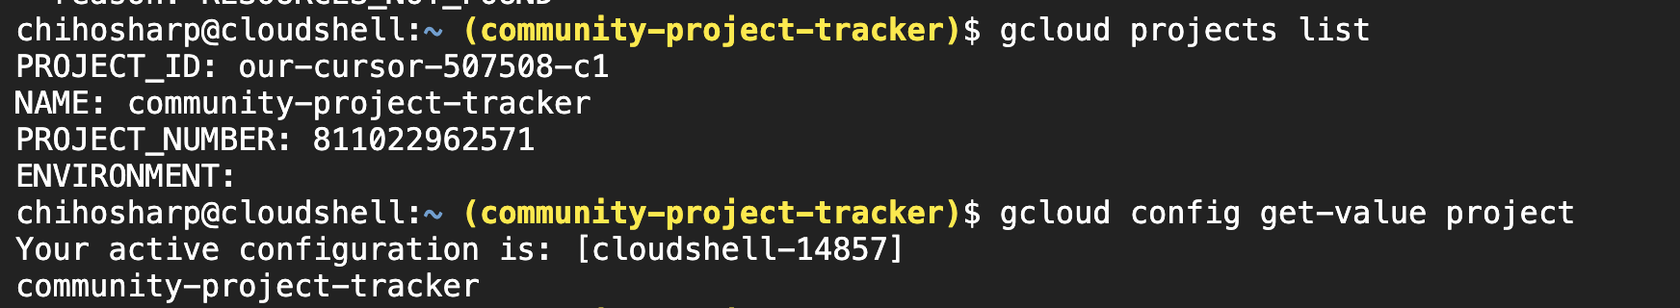
Make sure you are in the correct project ID.
our-cursor-507508-c1

Slide 17
2. Enable the APIs
We'll use Cloud Run, Firestore and BigQuery.
2. Firestore
gcloud services enable firestore.googleapis.com
1. Cloud run
gcloud services enable run.googleapis.com
3.BigQuery
gcloud services enable bigquery.googleapis.com
4.Cloud Build
gcloud services enable cloudbuild.googleapis.com
We need Cloud Build because Cloud Run source deployment uses Google Cloud buildpacks/Cloud Build to build the application automatically.
Notes:
gcloud services enable run.googleapis.com
gcloud services enable firestore.googleapis.com
gcloud services enable bigquery.googleapis.com
gcloud services enable cloudbuild.googleapis.com
We need Cloud Build because Cloud Run source deployment uses Google Cloud buildpacks/Cloud Build to build the application automatically.

Slide 18
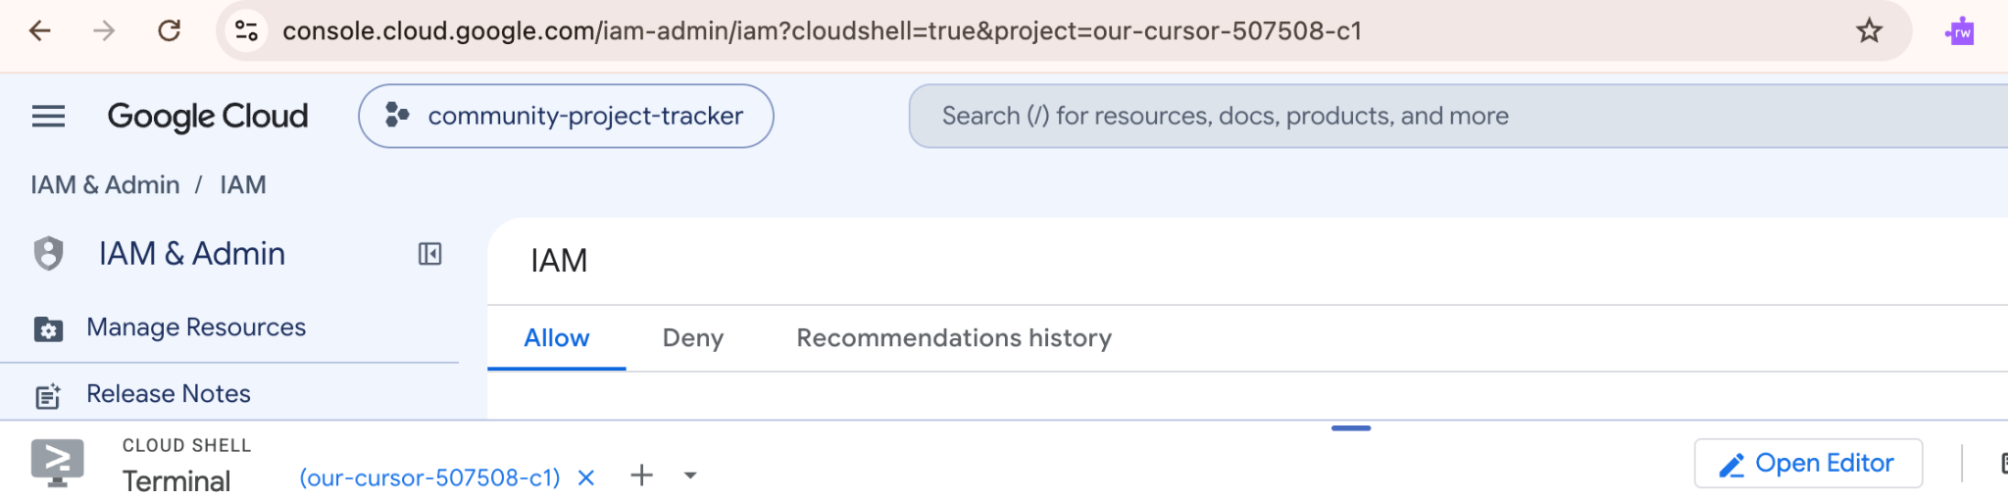
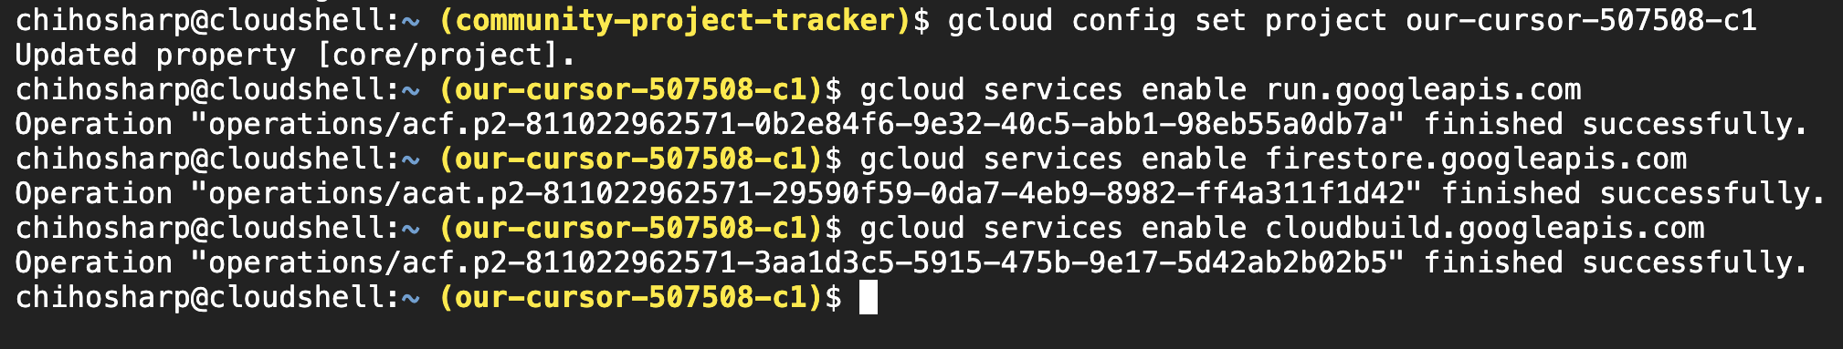

Slide 19
Create a Database in Firestore
STEP 01
Check Database
First, verify if a default database already exists in your project:
gcloud firestore databases list
If you already have (default), do not create another one.
STEP 02
Initialize
If you don't have one, run this command to create it:
gcloud firestore databases create \
--database="(default)" \
--location=europe-west1
For this project, we must use Firestore Native mode.
STEP 03
Verify Setup
Check again to confirm proper initialization:
gcloud firestore databases list
Expected output similar to:
(default) europe-west1 FIRESTORE_NATIVE
Notes:
gcloud firestore databases list
gcloud firestore databases create \
--database="(default)" \
--location=europe-west1
gcloud firestore databases list

Slide 20
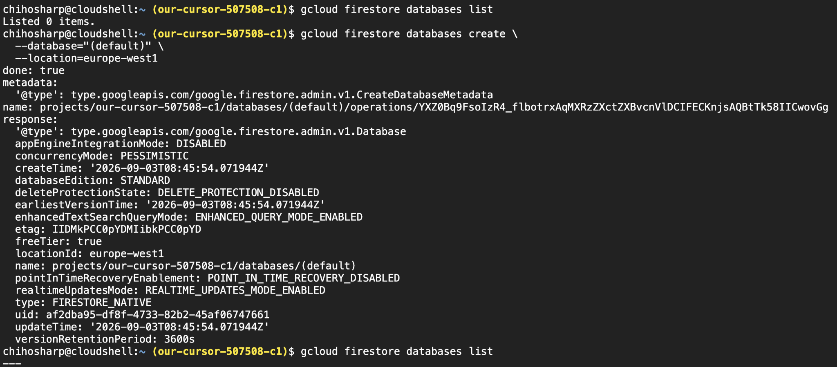

Slide 21
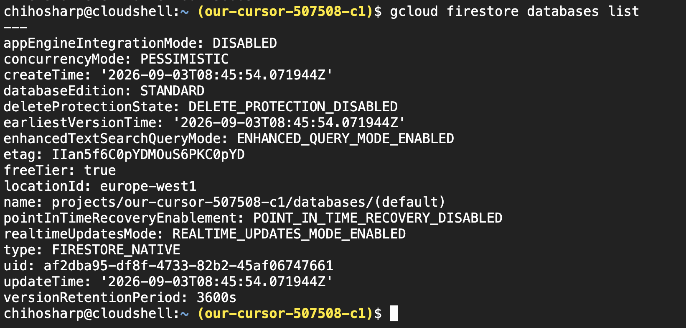

Slide 22
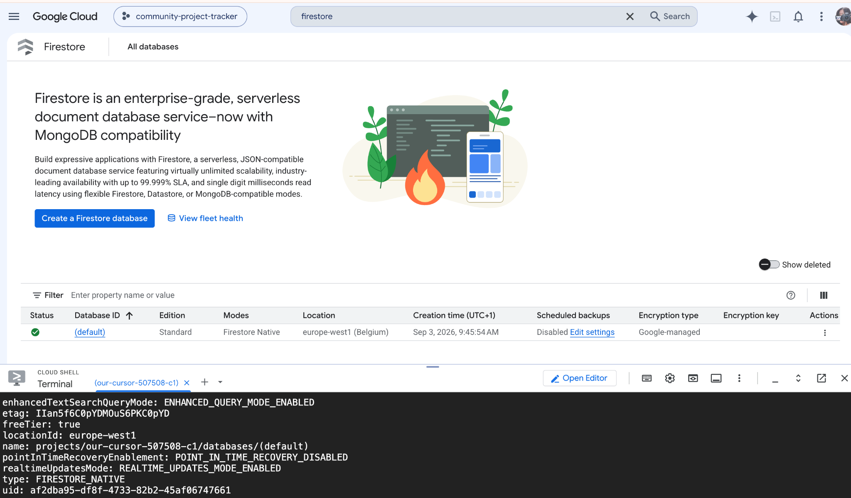
Open Firestore page to see if the database (default) is created.

Slide 23
Create the BigQuery dataset
Now we're going to create the analytics dataset.
BigQuery Hierarchy
Command Execution
Run the following command to create the dataset:
BigQuery
bq mk \
--dataset \
--location=europe-west1 \
YOUR_PROJECT_ID:community_analytics
Dataset (We'll call it)
community_analytics
For example (with a project ID):
bq mk \
--dataset \
--location=europe-west1 \
community-project-tracker-123:community_analytics
Table
Datasets are top-level containers for tables and views; location is chosen on creation.
See what you created.
Run: bq ls
Run: bq show our-cursor-507508-c1:community_analytics
Notes:
Run:
bq mk \
--dataset \
--location=europe-west1 \
YOUR_PROJECT_ID:community_analytics
For example:
bq mk \
--dataset \
--location=europe-west1 \
community-project-tracker-123:community_analytics

Slide 24
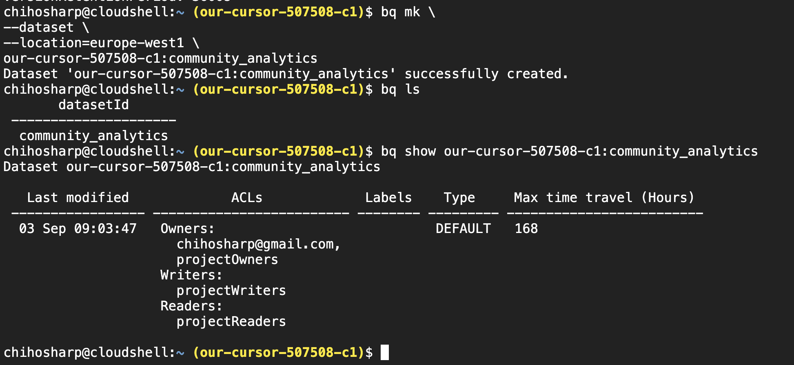
Check the dataset you’ve just created in BQ

Slide 25
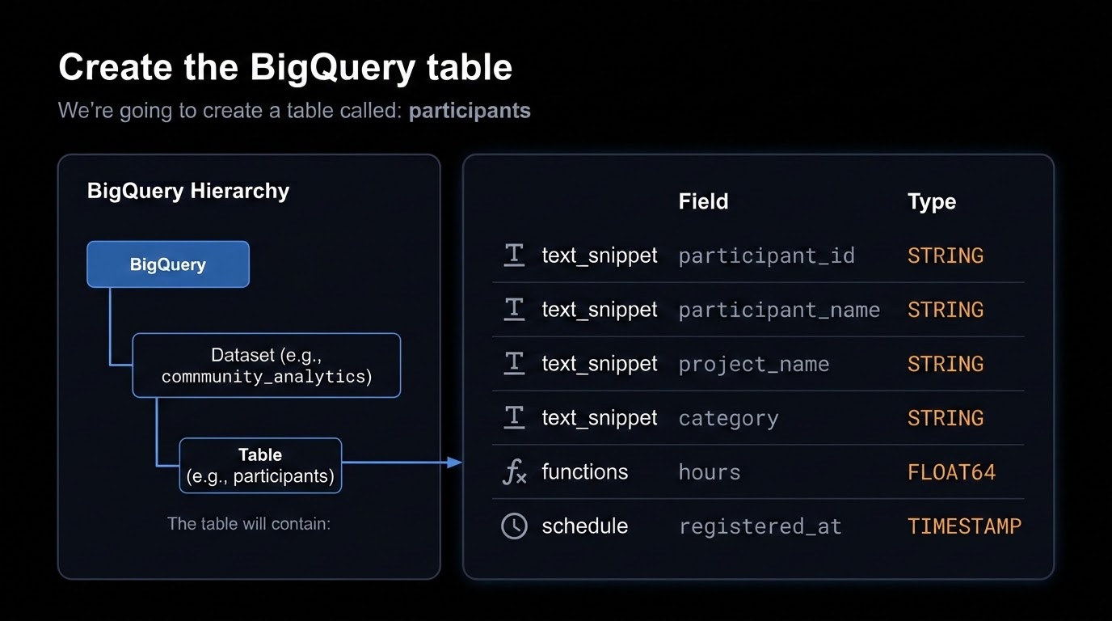
Create a BigQuery Table
We are going to create a table called “Participants”

Slide 26
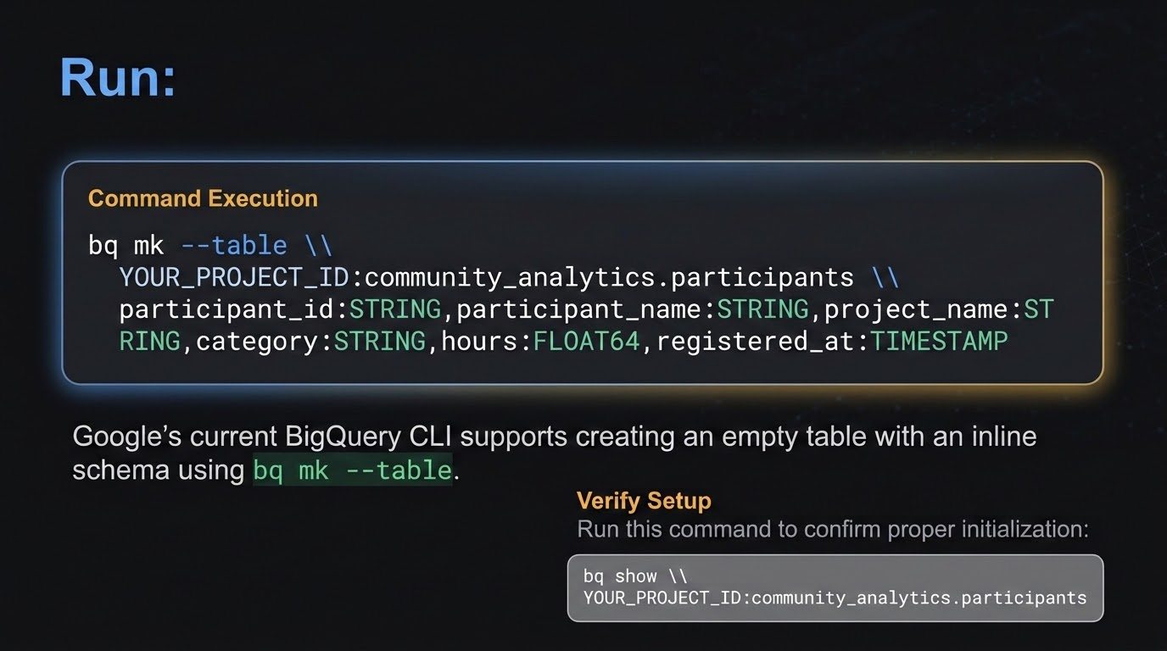
Notes:
bq mk --table \
YOUR_PROJECT_ID:community_analytics.participants \
participant_id:STRING,participant_name:STRING,project_name:STRING,category:STRING,hours:FLOAT64,registered_at:TIMESTAMP
bq show \
YOUR_PROJECT_ID:community_analytics.participants

Slide 27
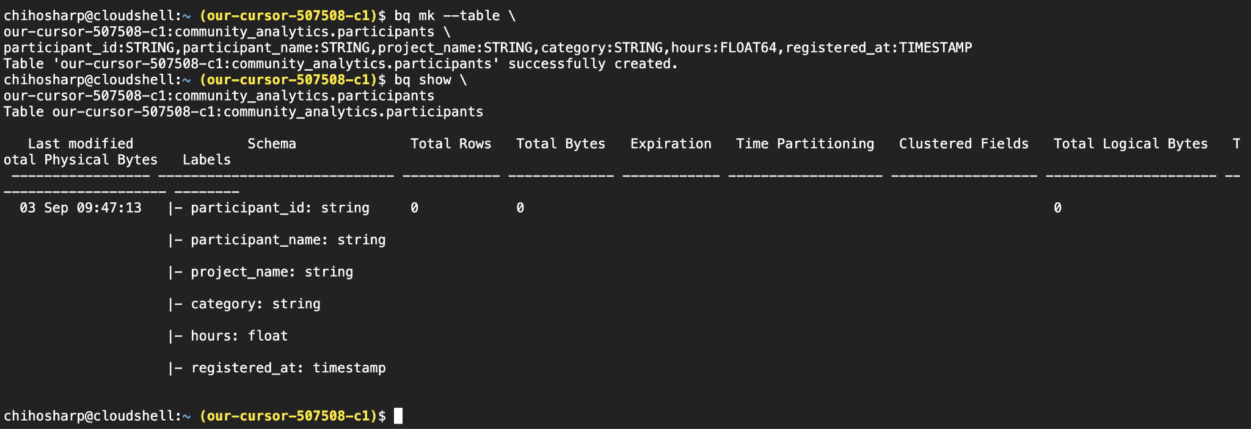
It should look like this.

Slide 28
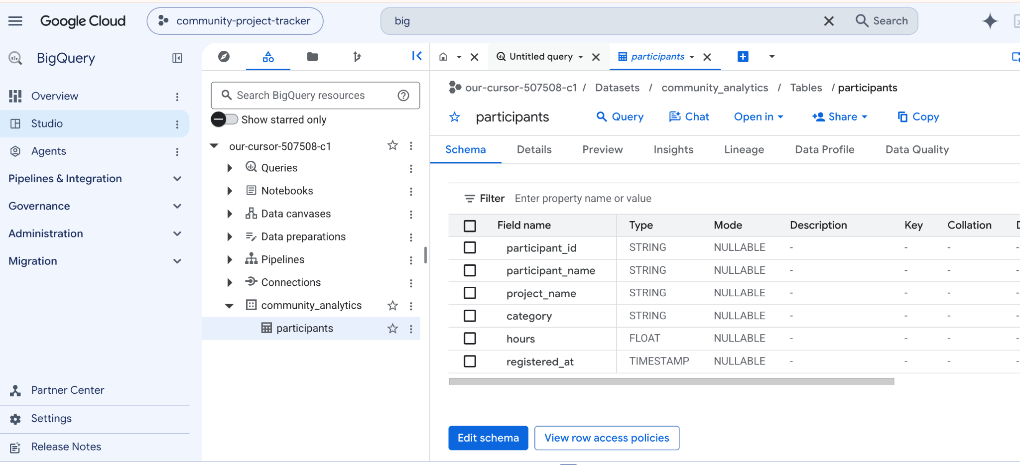
You can see what you created in BigQuery.

Slide 29
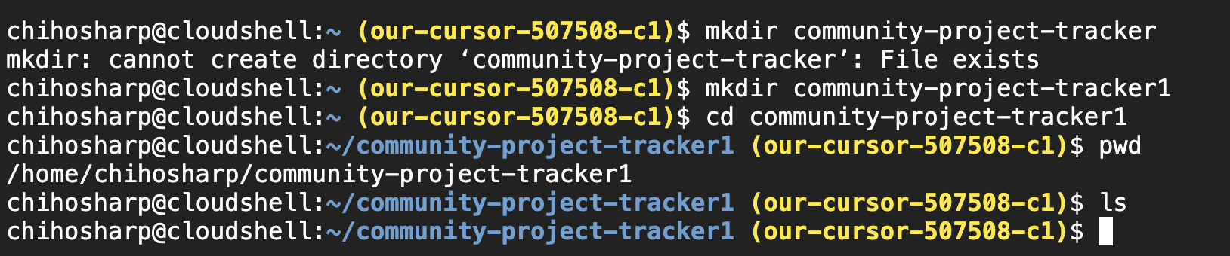
Create an application folder
Notes:
mkdir community-project-tracker1
Cd community-project-tracker1

Slide 30
Create the Python application
Step 01
Create File
Create the main file in your workspace directory:
$ touch main.py
Step 02
Open Editor
Open the file in Cloud Shell. You can click:
Open Editor
from Cloud Shell.
Step 03
Verify Structure
Your folder structure should look like this:
community-project-tracker/
└── main.py
We will use Python + Flask to build the application.
Notes:
https://docs.google.com/document/d/1pRHKBXr2n1lP766WTaq76rjcHmMGCfzXP6KndZyivLk/edit?usp=sharing
Main py command

Slide 31
Create the Python application
Notes:
https://docs.google.com/document/d/1pRHKBXr2n1lP766WTaq76rjcHmMGCfzXP6KndZyivLk/edit?usp=sharing

Slide 32
Create requirements.txt
Add Dependencies
Create a requirements.txt file and define the required packages:
Flask==3.1.3
google-cloud-firestore
google-cloud-bigquery
gunicorn
Project Structure
Your directory layout should now look like this:
community-project-tracker/
├── main.py
└── requirements.txt
Notes:
https://docs.google.com/document/d/1WtrMh7gcSkoB-6CtVQWfkOCdqDyr55eETX4eFGnZQnA/edit?usp=sharing
Flask==3.1.3
google-cloud-firestore
google-cloud-bigquery
gunicorn

Slide 33
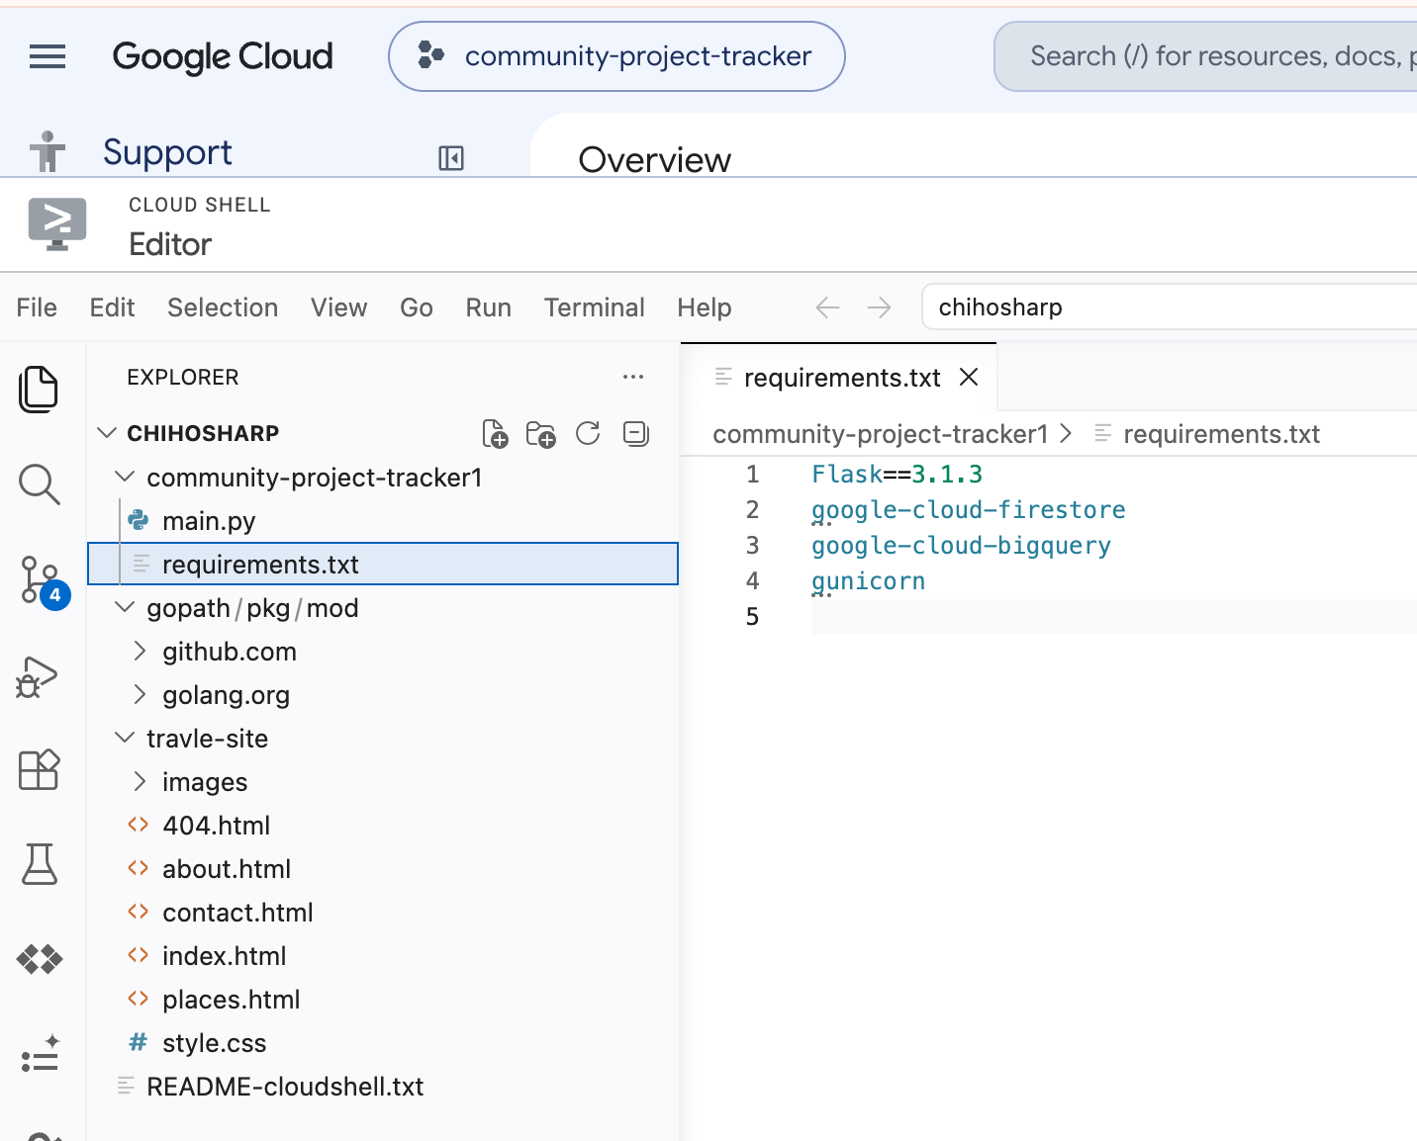

Slide 34

Understand the data flow
This is probably the most important part of the exercise. When a participant registers:
personParticipant
cloud_queueCloud Run
storageFirestore
analyticsBigQuery
Operational data
Analytics data

Slide 35

The application performs two writes.
Write 1: Operational Database
Stores the immediate application state in Firestore.
firestore_client.collection(
"participants"
)
➔ Operational record storage
Write 2: Analytics Warehouse
Streams transaction records directly to BigQuery.
bigquery_client.insert_rows_json(
TABLE_FULL_ID,
[row]
)
➔ Analytics record storage
KEY TEACHING POINT
"The same business event can be represented differently for operational use and analytical use."

Slide 36
Configure IAM
Key Concept
Service Identity & IAM
Cloud Run uses a service account as its service identity when its code calls Google Cloud APIs.
Learn how to securely authorize application access between serverless services.
Required Access
Allow Cloud Run to access:
Firestore
Operational Database
BigQuery
Analytics Warehouse

Slide 37
Find the Project Number
GET PROJECT NUMBER
Run Command
Execute this gcloud command in your terminal to retrieve the project number:
cd project ID
gcloud projects describe YOUR_PROJECT_ID \
--format="value(projectNumber)"
Example Output:
123456789012
SERVICE IDENTITY
Default Service Account
The default Compute Engine service account format is constructed using the project number:
123456789012-compute@developer.gserviceaccount.com
➔ Generally pre-configured with required access
Notes:
gcloud projects describe YOUR_PROJECT_ID \
--format="value(projectNumber)"

Slide 38
Give Cloud Run access to Firestore
EXECUTE IN TERMINAL
Add IAM Binding
Run this command to grant the default Compute Engine service account access to Firestore:
gcloud projects add-iam-policy-binding YOUR_PROJECT_ID \
--member="serviceAccount:PROJECT_NUMBER-compute@developer.gserviceaccount.com" \
--role="roles/datastore.user"
ROLE & PARAMETERS
Configuration Details
1. Replace Project Number
Ensure you replace PROJECT_NUMBER with your actual GCP project number.
2. Datastore User Role
The roles/datastore.user role provides full read/write access to data in your Firestore/Datastore database.
Notes:
cd community-project-tracker
gcloud projects add-iam-policy-binding YOUR_PROJECT_ID \
--member="serviceAccount:PROJECT_NUMBER-compute@developer.gserviceaccount.com" \
--role="roles/datastore.user"

Slide 39
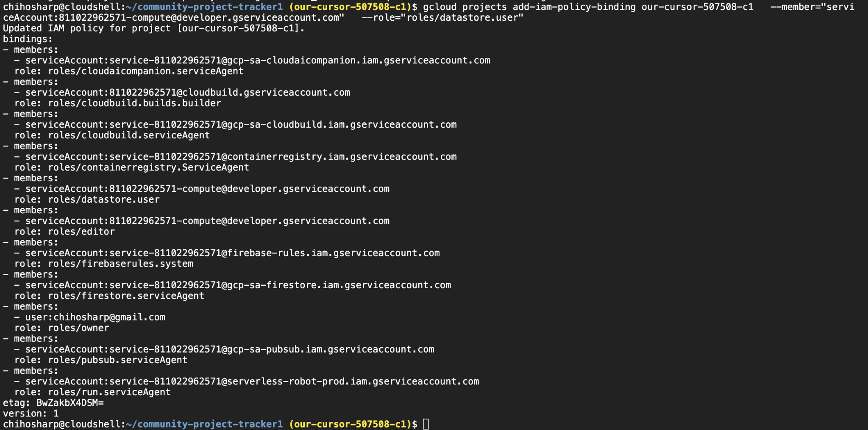

Slide 40
Give Cloud Run access to BigQuery
ROLE & PERMISSION
BigQuery Data Editor
This allows the application to read and write the table data.
ROLE & PERMISSION
BigQuery Job User
This allows the application to run BigQuery queries.
Note: Google's current IAM documentation states that BigQuery Data Editor granted at dataset level allows reading and updating table data, while BigQuery Job User provides permission to run jobs such as queries.
Notes:
https://docs.cloud.google.com/iam/docs/roles-permissions/bigquery?utm_source=chatgpt.com

Slide 41
Configure Service Identity Permissions
Cloud Run Service Identity
STEP 1: DATASET ACCESS
gcloud projects add-iam-policy-binding \
YOUR_PROJECT_ID:community_analytics \
--member="serviceAccount:PROJECT_NUMBER... \
--role="roles/bigquery.dataEditor"
STEP 2: JOB CREATION POWER
gcloud projects add-iam-policy-binding \
YOUR_PROJECT_ID \
--member="serviceAccount:PROJECT_NUMBER... \
--role="roles/bigquery.jobUser"
ROLE: roles/datastore.user
➔ Firestore
ROLE: roles/bigquery.dataEditor
➔ BigQuery Dataset
ROLE: roles/bigquery.jobUser
➔ BigQuery Queries
This architecture safely limits access to only required Firestore and BigQuery resources.
Notes:
gcloud projects add-iam-policy-binding \
YOUR_PROJECT_ID:community_analytics \
--member="serviceAccount:PROJECT_NUMBER-compute@developer.gserviceaccount.com" \
--role="roles/bigquery.dataEditor"
Then:
gcloud projects add-iam-policy-binding YOUR_PROJECT_ID \
--member="serviceAccount:PROJECT_NUMBER-compute@developer.gserviceaccount.com" \
--role="roles/bigquery.jobUser"

Slide 42
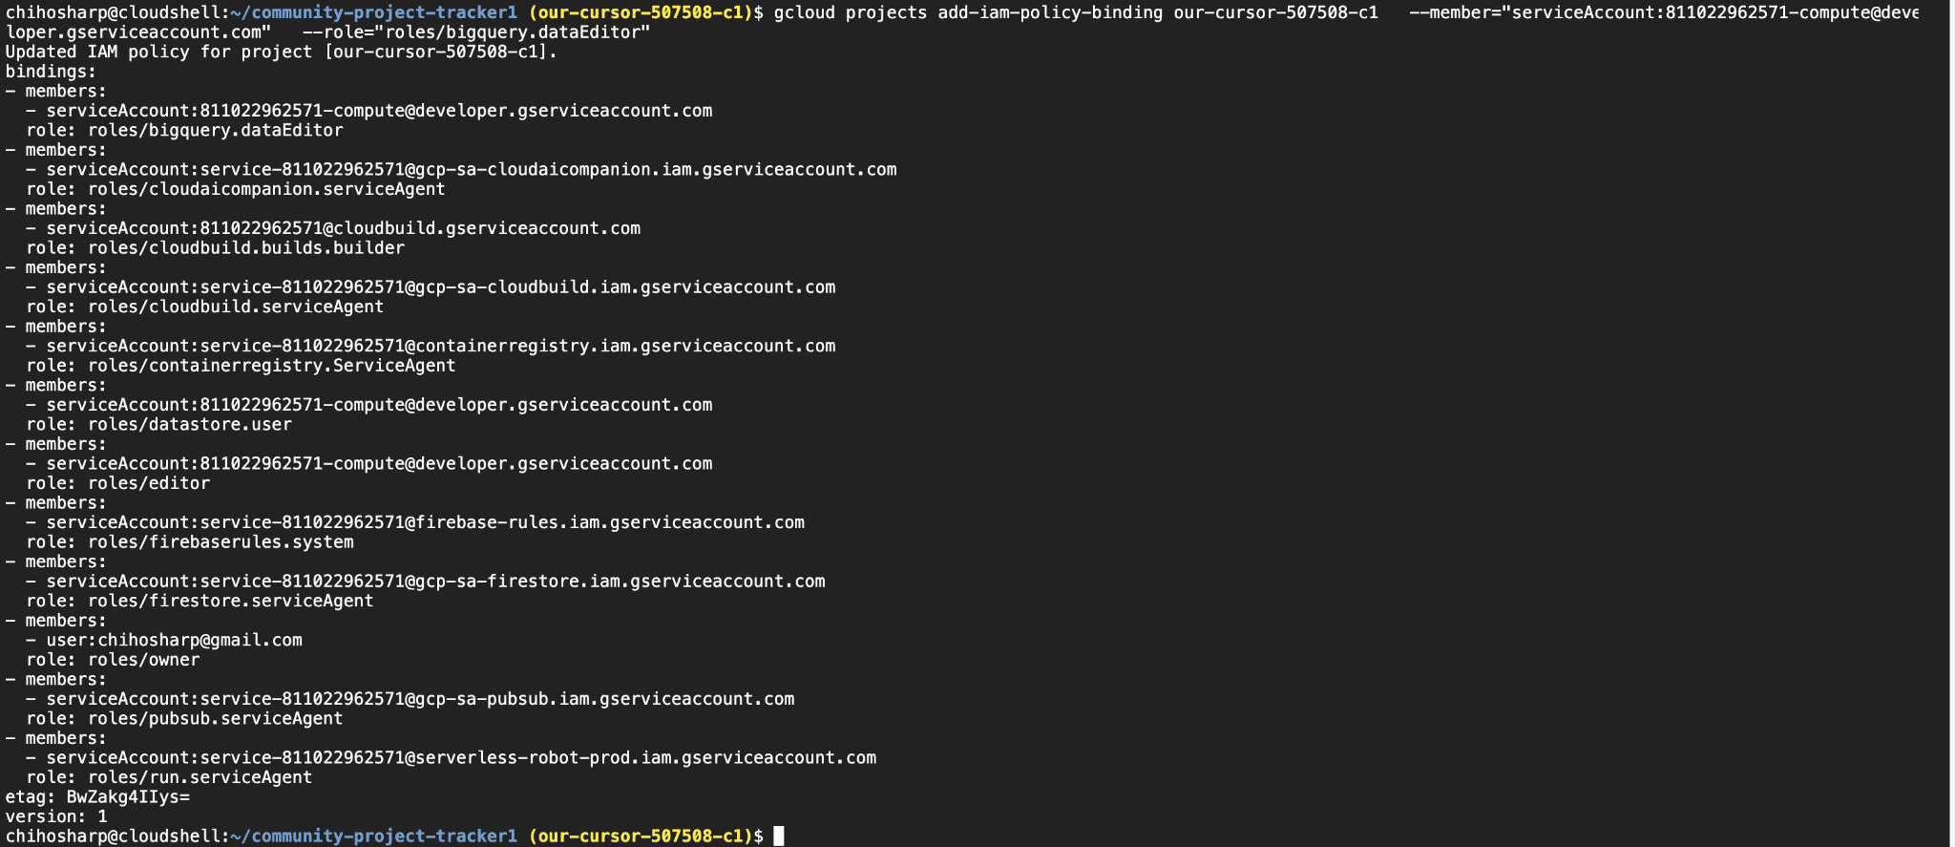
Configure Service Identity Permissions bigQuery. dataEditor
Notes:
gcloud projects add-iam-policy-binding \
YOUR_PROJECT_ID:community_analytics \
--member="serviceAccount:PROJECT_NUMBER-compute@developer.gserviceaccount.com" \
--role="roles/bigquery.dataEditor"
Then:
gcloud projects add-iam-policy-binding YOUR_PROJECT_ID \
--member="serviceAccount:PROJECT_NUMBER-compute@developer.gserviceaccount.com" \
--role="roles/bigquery.jobUser"

Slide 43
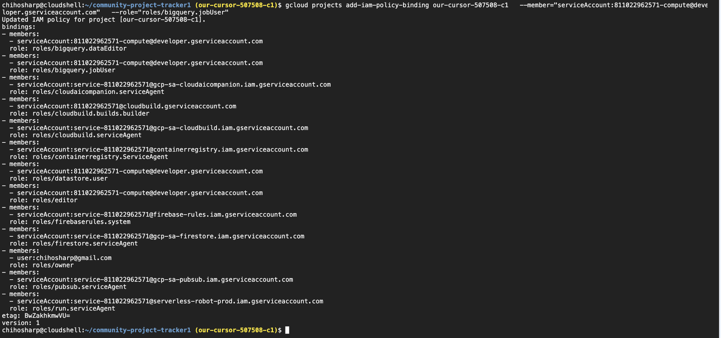
Configure Service Identity Permissions bigQuery. jobUser
Notes:
gcloud projects add-iam-policy-binding \
YOUR_PROJECT_ID:community_analytics \
--member="serviceAccount:PROJECT_NUMBER-compute@developer.gserviceaccount.com" \
--role="roles/bigquery.dataEditor"
Then:
gcloud projects add-iam-policy-binding YOUR_PROJECT_ID \
--member="serviceAccount:PROJECT_NUMBER-compute@developer.gserviceaccount.com" \
--role="roles/bigquery.jobUser"

Slide 44
Deploy to Cloud Run
EXECUTE DEPLOYMENT COMMAND
Run from the community-project-tracker directory:
gcloud run deploy community-project-tracker \
--source . \
--region europe-west1 \
--allow-unauthenticated \
--set-env-vars GOOGLE_CLOUD_PROJECT=our-cursor-507508,BIGQUERY_DATASET=community_analytics,BIGQUERY_TABLE=participants
INTERACTIVE PROMPT
When asked during deployment:
Allow unauthenticated invocations?
YSelect Yes for this classroom project
Cloud Run's source deployment automatically builds and deploys the application from the source directory. See Google Cloud Docs.
Notes:
cd community-project-tracker (If you are not in the file)
gcloud run deploy community-project-tracker \
--source . \
--region europe-west1 \
--allow-unauthenticated \
--set-env-vars GOOGLE_CLOUD_PROJECT=community-project-tracker,BIGQUERY_DATASET=community_analytics,BIGQUERY_TABLE=participants

Slide 45
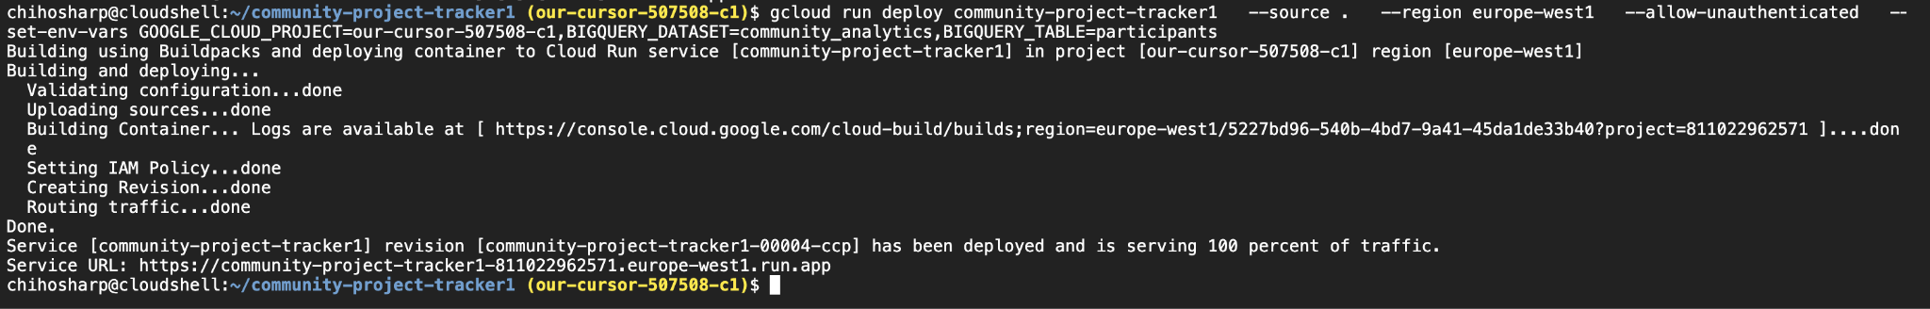
Deploy to Cloud Run

Slide 46
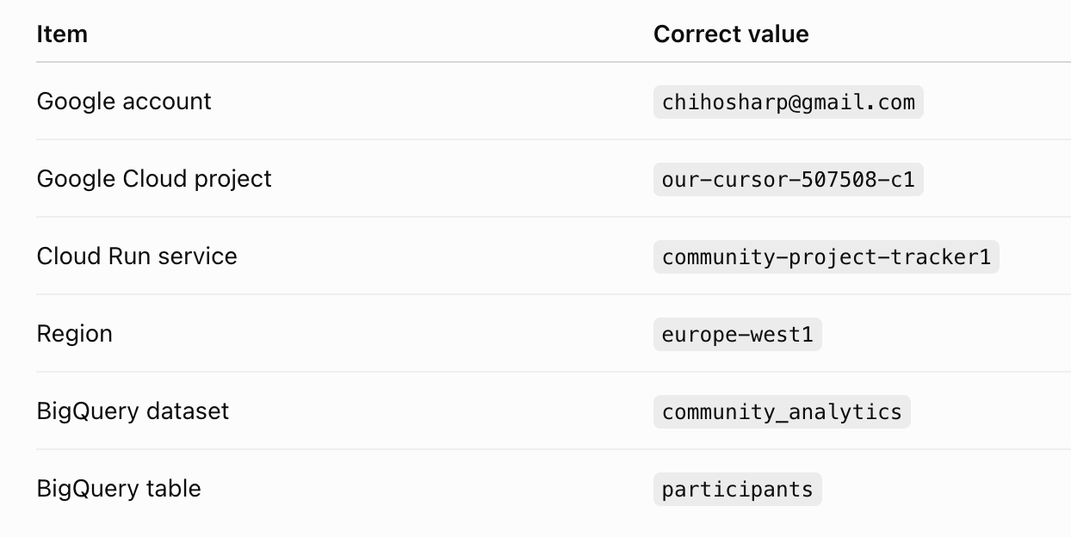

Slide 47
Open the application
Get the deployment URL
At the end of deployment, Cloud Run will give you a Service URL such as:
https://community-project-tracker-xxxxx-ew.a.run.app
Verify Application
Open the URL in your browser:
You should see:
🌱 Community Project Tracker
Notes:
https://community-project-tracker-653862733743.europe-west1.run.app/

Slide 48
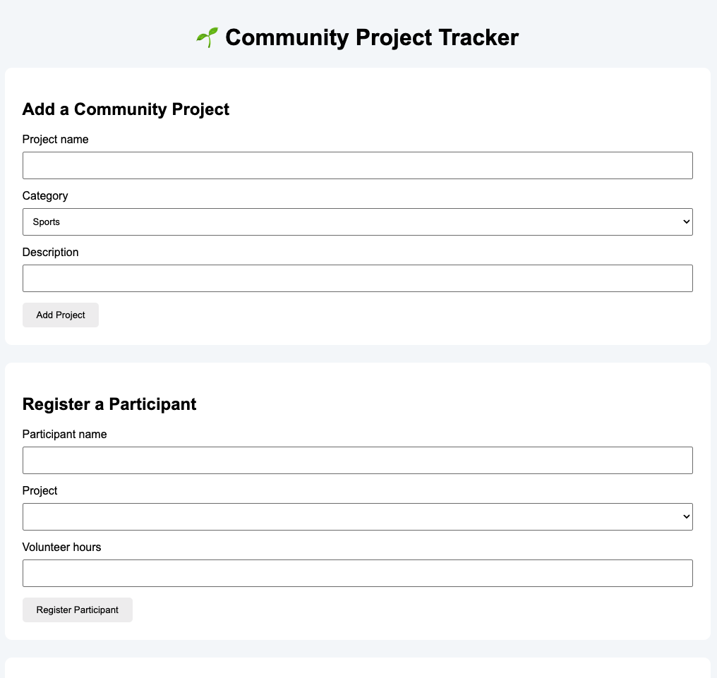

Slide 49

Add some projects
Project 1
Community Table Tennis
SPORTS
Weekly community table tennis sessions
Project 2
Digital Skills Workshop
EDUCATION
Basic digital skills for local residents
Project 3
Community Garden
ENVIRONMENT
Local gardening and environmental project

Slide 50
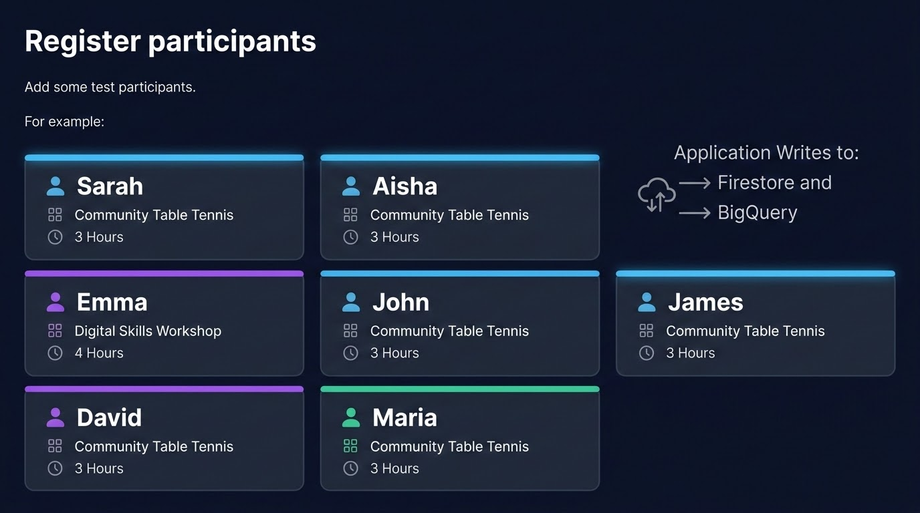

Slide 51
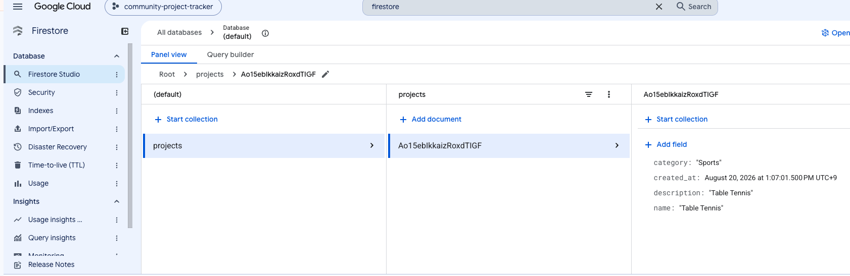
Look at Firestore
Open:Google Cloud ConsoleFirestoreData

Slide 52
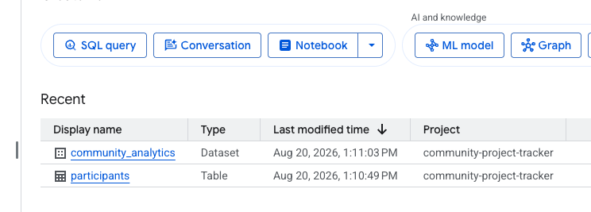
Look at BigQuery
Open:
BigQuery → community_analytics → participants

Slide 53
Run your first BigQuery query
In BigQuery's SQL editor, run:
query.sql
SELECT
project_name,
COUNT(*) AS participants
FROM
`YOUR_PROJECT_ID.community_analytics.participants`
GROUP BY
project_name
ORDER BY
participants DESC;
Notes:
SELECT
project_name,
COUNT(*) AS participants
FROM
`YOUR_PROJECT_ID.community_analytics.participants`
GROUP BY
project_name
ORDER BY
participants DESC;

Slide 54
Analyse volunteer hours
In BigQuery SQL editor, run this query to aggregate and analyze participant data:
query.sql
SELECT
project_name,
SUM(hours) AS total_hours
FROM
`YOUR_PROJECT_ID.community_analytics.participants`
GROUP BY
project_name
ORDER BY
total_hours DESC;
KEY QUESTION ANSWERED
Which community project generated the most volunteer hours?
Notes:
SELECT
project_name,
SUM(hours) AS total_hours
FROM
`YOUR_PROJECT_ID.community_analytics.participants`
GROUP BY
project_name
ORDER BY
total_hours DESC;

Slide 55
Compare categories
Now introduce a slightly more interesting analytical question:
query.sql
SELECT
category,
COUNT(*) AS participants
FROM
`YOUR_PROJECT_ID.community_analytics.participants`
GROUP BY
category
ORDER BY
participants DESC;
KEY QUESTION
Which type of community project attracts the most participants?
Students are now doing real data analytics.
Notes:
Compare categories
Now introduce a slightly more interesting analytical question:
Which type of community project attracts the most participants?
SELECT
category,
COUNT(*) AS participants
FROM
`YOUR_PROJECT_ID.community_analytics.participants`
GROUP BY
category
ORDER BY
participants DESC;

Slide 56
Interactive Session
The architecture discussion
QUESTION 1
Why don't we use BigQuery as the main application database?
QUESTION 4
What happens if the Cloud Run service doesn't have roles/datastore.user?
QUESTION 2
Why don't we use Firestore for large analytical queries?
QUESTION 5
What happens if it doesn't have permission to write to BigQuery?
QUESTION 3
Why does Cloud Run need a service account?
QUESTION 6
Why should we avoid giving Cloud Run the Owner role?

Slide 57
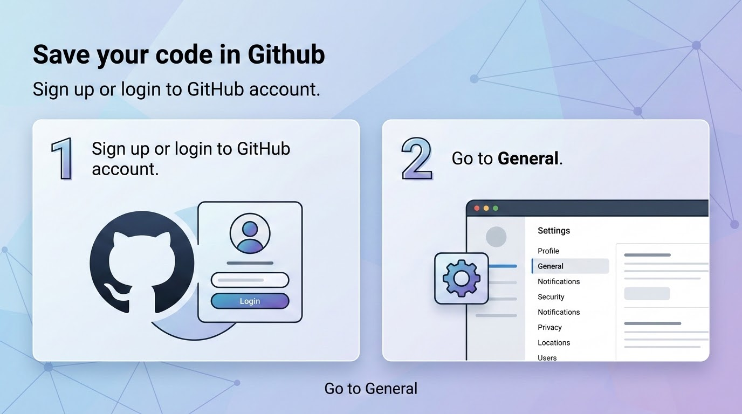
Save your code in Github
Sign up or login to GitHub account
Go to General

Slide 58
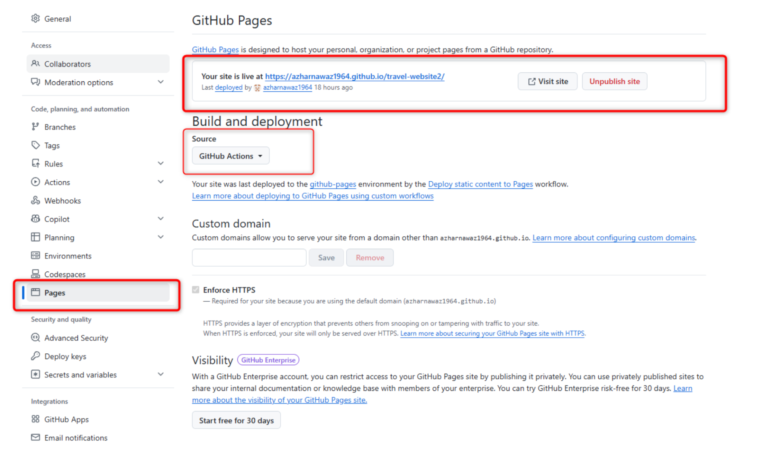

Slide 59
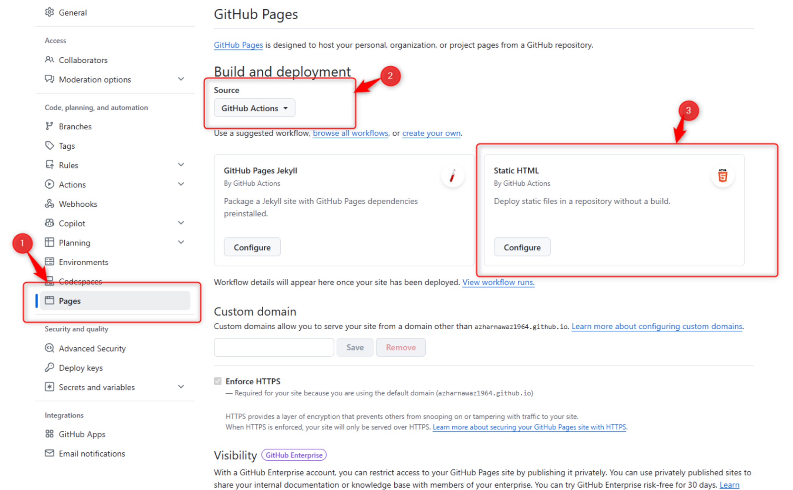

Slide 60
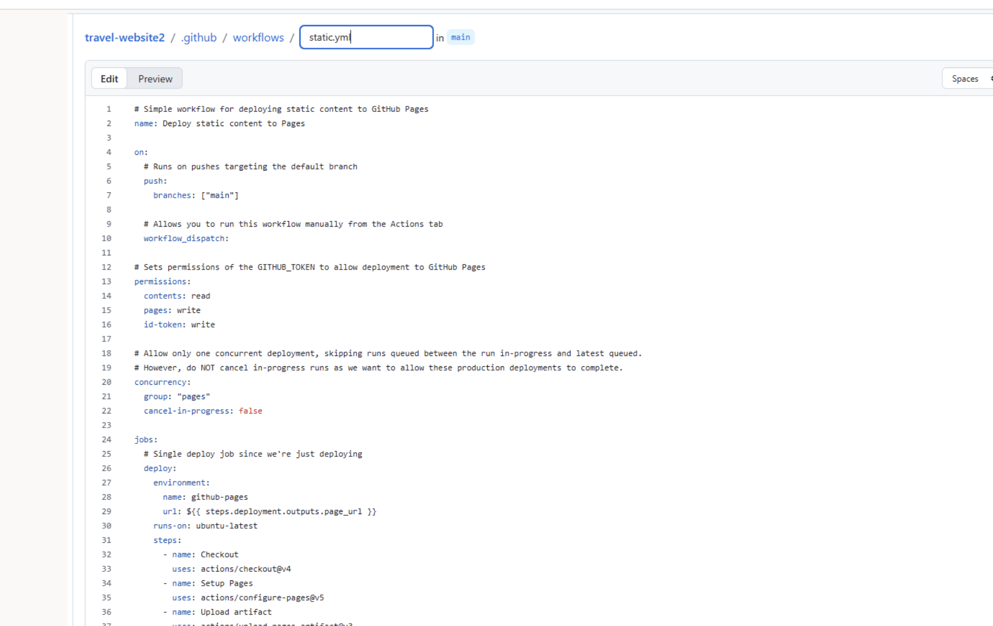

Slide 61
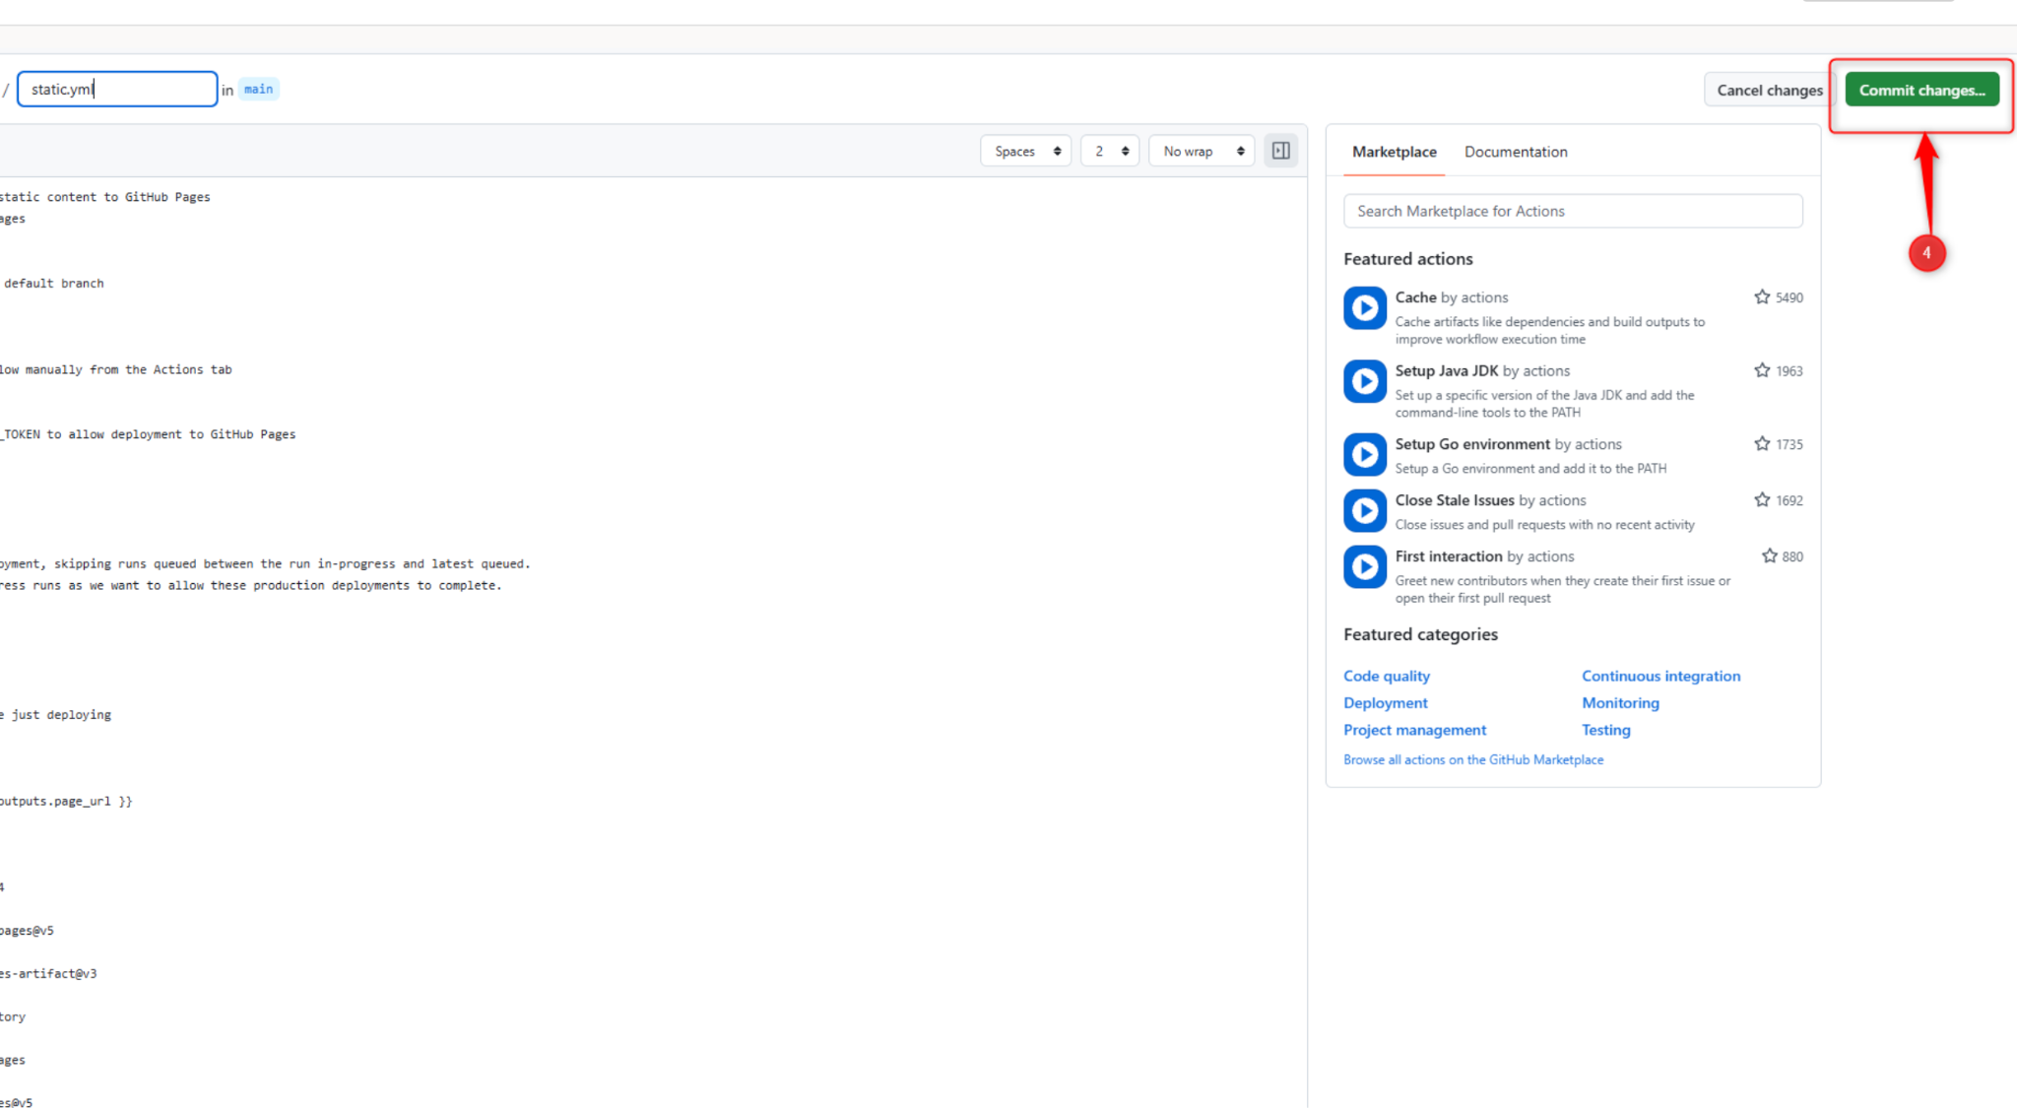

Slide 62
CLOUD PRINCIPLE
Stop and delete Unused Resources and projects
“Go to IAM, Manage Resources” to delete the projects”
One of the most critical cloud optimisation principles is shutting down idle assets to actively prevent billing leaks.
power_settings_new

Slide 63

SUCCESS
Project Completed!
Congratulations

Slide 64

QUESTIONS
Any questions?
Thank you for your time. Feel free to ask anything
or share your thoughts.

